Slide 1
Embedded Systems Introduction

Slide 2
Reminders
Class Mon/Wed/Fri
Mon / Wed in person WAL A420 9 – 9:50am
Friday is ONLINE 9 – 9:50am
These will be working group sessions
If you have completed the demo or lab for that given day ahead of time attendance is not required.
Obtain DE1-SoC board
Follow instructions in announcements
Download Quartus Prime Lite 18.1
Be sure it is 18.1 or you will have a tool variation from the labs
Review Syllabus and Schedule
myCourses overview

Slide 3
Schedule This Semester
Complete first Quiz – Due Sunday
Quizzes section of myCourses
Each week quizzes will cover material from lecture
Typically 10 questions, 15 minutes
Be sure to review weeks material before you take the quiz!
Complete first Demo assignment – Due Friday
Dropbox video or documentation on myCourses
Lab due dates posted in schedule
No reports
Zip entire project for reproduction
Paper signoffs
TA: Santi Sanchez

Slide 4
What is an Embedded System?
Any system that includes a programmable computer, but is not itself a general purpose computer
A microprocessor-based system that is built to control a function or a range of functions and is not designed to be programmed by the end user
A system designed to perform one specific task and is optimized for that application

Slide 5
Problems With Given Definition
Field is outgrowing traditional descriptions as technology advances and cost of implementation of various hardware and software components decreases.
Devices such as smart phones designed to do a variety of functions and run a variety of applications.
Where does the iPad fit in?

Slide 6
How Do Embedded Systems Differ From PCs?
Embedded System
PC
Specific application that is known at design time
Not programmable by end user
Optimized for fixed run-time requirements
Criteria
Cost
Reliability
Power consumption
size
Broad class of applications
Programmable by end user
Faster is better
Criteria
Cost
Average speed

Slide 7
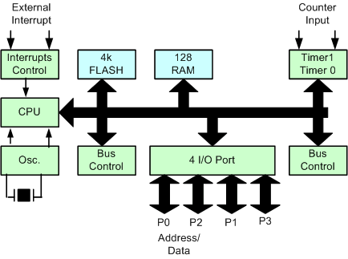
Components of an Embedded System
Program Memory
(Non-volatile)
Data Memory
(Volatile)
Micro-processor
Processor
Memory
I/O
Input/Output

Slide 8
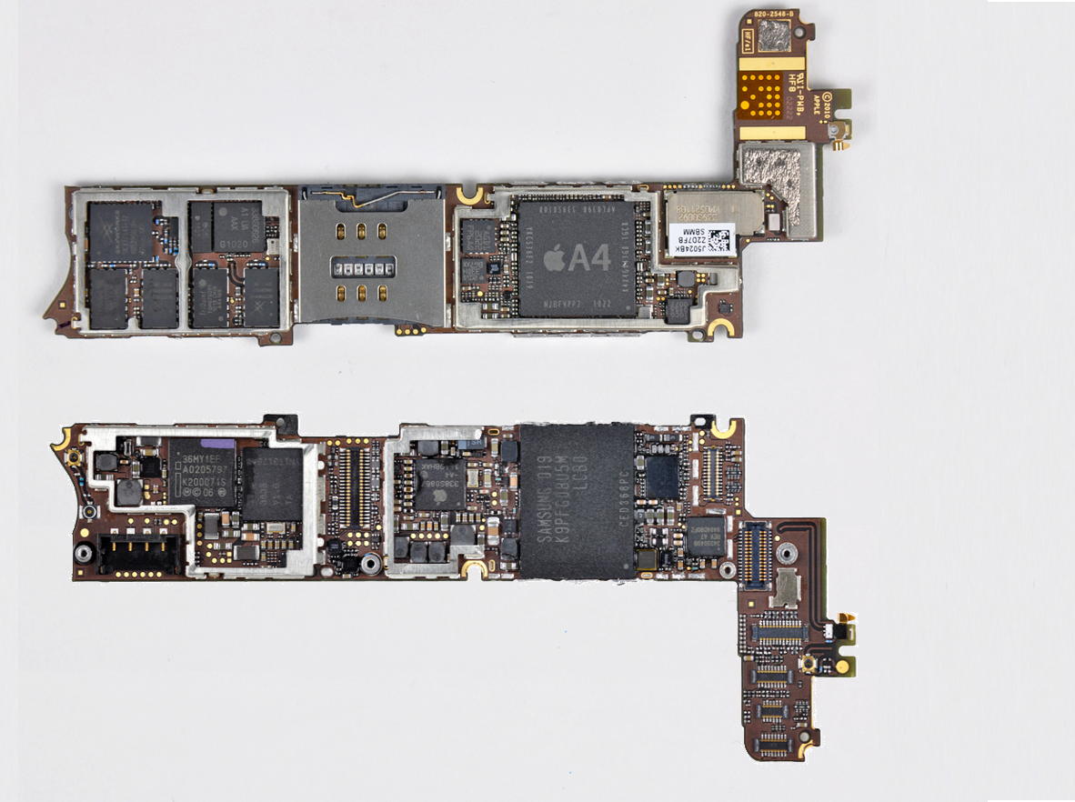
Components of an Embedded System (iPhone 4)
ARM Processor
CPU
top
view
bottom
view
I/O
RAM
ROM
Touch
Screen
Controller
128 M-Bit SDRAM
256G x8
Flash

Slide 9
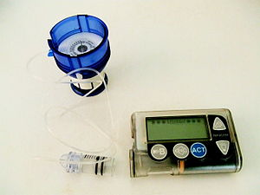
Characteristics of Embedded Systems
Must be dependable:
Higher quality and reliability requirements than other types of computer systems
Control critical functions
medical applications
automobile safety features
security measures
military applications
and more ….

Slide 10
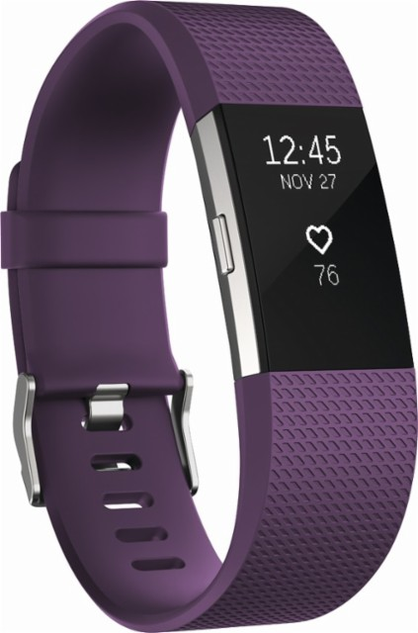
Characteristics of Embedded Systems
Must be efficient:
Consumers are demanding
Mass-market items must have low manufacturing costs
So… systems need to be
Energy efficient – many are battery powered
Code-size efficient – memory size is limited to keep device small
Weight efficient
Cost efficient

Slide 11
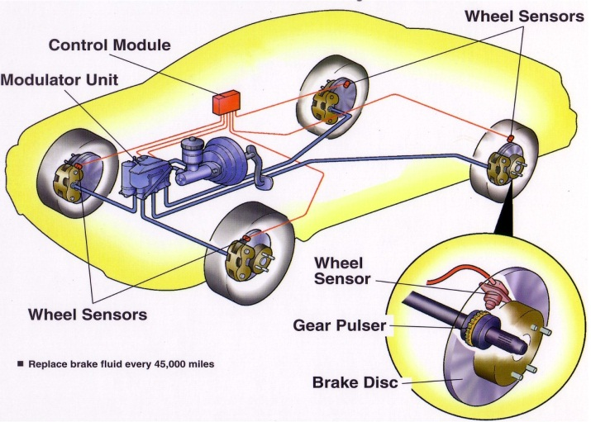
Characteristics of Embedded Systems
Must meet real-time constraints:
A real-time system must react to stimuli immediately
Must finish operations by deadlines
Hard constraint: missing deadline causes failure
Soft constraint: missing deadline results in degraded performance

Slide 12
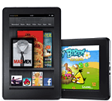
Characteristics of Embedded Systems
Must meet time-to-market constraints
Typically 6 to 8 months
Possible Revenue
Market Window
Time

Slide 13
Embedded System Technologies
Current Technologies
Microprocessor based
Available in 8-bit, 16-bit, or 32-bit
Ex: Intel 80x86, Pentium, PowerPC, ARM
Microcontroller based
Specialized processor that include on-chip memory, D2A, A2D, etc
Ex: TI MSP430, Renesas RX, Freescale, Coldfire, Arduino, etc
DSP Based
Processor optimized for mathematical operations
Ex: Texas Instruments C64x, Analog Device Blackfin
FPGA Based
Technology moving towards higher level integration
Discrete components ➔ more functionality per each device
ASIC / ASSP / SOC / SOPC

Slide 14
Embedded System Technologies
Application-Specific Integrated Circuit (ASIC)
Device created with a specific purpose
Typically designed and used by single company
Development expensive, time-consuming, & resource-intensive
High performance coupled with low power consumption
Algorithm or design fixed in silicon

Slide 15
Embedded System Technologies
Application-Specific Standard Parts (ASSP)
Designed and implementation same as ASIC
More general-purpose device for use by multiple systems
Marketed to multiple customers with specific application
Ex: USB interface chip
High performance coupled with low power consumption
Algorithm or design fixed in silicon
System-on-Chip (SOC)
ASIC or ASSP that contains one or more processors
SOC also contains other stuff
On-chip memory, hardware accelerator, peripheral, etc
Algorithm or design fixed in silicon

Slide 16
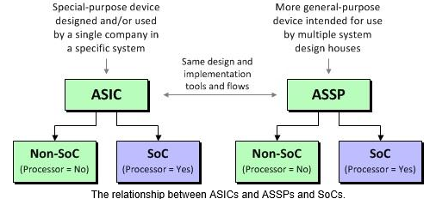
Embedded System Technologies
Simplified Relationship Diagram
www.programmableplant.com: ASICs vs. ASSPs vs. SoCs vs. FPGAs

Slide 17
Embedded System Technologies
Field Programmable Gate Array (FPGA)
Programmable logic device that is configured by designer
“Sea of Gates”
Require programming before using (SRAM based)
Development is inexpensive and easier to perform
Shorter cycles between development & prototyping
Easy to change, modify or expand design
High power consumption with lower performance
System-on-Programmable-Chip (SOPC)
Basically same as an SOC but in programmable device
A very large FPGA that takes the place of ASIC/ASSP
Development is inexpensive and easier to perform
Allows ASIC / ASSP designer a platform to develop on

Slide 18
Embedded System Technologies
SOPC (con’t)
FPGA contains one or more processors
SOPC also contains on-chip memory, hardware accelerator, peripheral, etc
Processors, memories, and other components can be built into the FPGA (hard-core) or created from the programmable fabric (soft-core).
The focus of CPET-561

Slide 19
Embedded System Technologies
SOPC compared to ASIC or ASSP
pros
Short lead times
Lower NRE (non-reoccurring engineering)
Design changes are easy (reprogram)
cons
Higher power
Cost is constant despite volume
Have to choose from off-the shelf parts
Not optimized

Slide 20
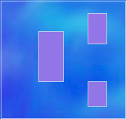

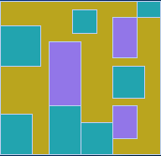
System on Programmable Chip
Designing an SOPC
Add user logic to tie everything together
Select a chip with required hard-cores (IP)
Add required soft-cores (IP)

Slide 21
Embedded System Design Considerations
System Partitioning
Determine where each function should be implemented
What task is done in hardware?
What task is done in software?
Hardest part of embedded design
How will system be used?
How should system respond?
Need to understand who has access to what and when?
Utilizes Use Cases to define partitioning
Technique for capturing functional requirements of systems
Forces you to think how the design partitions interact
Unified Development Process (UDP)
Grady Booch and James Rumbaugh
Notes:
What is a Software Architecture?
IEEE 1471
Architecture is the fundamental organization of a system embodied in its components, their relationship to each other, and to the environment, and the principles guiding its design and evolution.
High Level Structure
No implementation details!
Language agnostic
The core pieces of a software architecture
Identifying system components
Understand how components interact with
Other components
Their environment
Organizing the components into a system that is
Understandable
Modular
Maintainable

Slide 22
Embedded System Design Considerations
Design Challenges of Embedded System
How much hardware do we need?
How big of a processor do we need?
How much memory do we need?
How do we meet our design goal?
Do you use faster hardware or better software optimization?
How do we minimize power?
Do you slow system down?
Do you enable low power modes by shutting sections off?
How do we test/debug our system?
How to test real-time aspect?
What is the design environment?
Notes:
Why use a software architecture?
Define the elements in the design
Understand relationship of the components
Describe the structure and behavior of the system
Identify engineering decisions
Review and hash out the design before implementation
Identify holes in the requirements and implementation
How does one create a software architecture?
Component Lists – just a simple list of components needed (timer, PWM, ADC, PIO, etc)
Component Layer Architecture – Group components into Application vs driver
Flow Charts
Sequence Diagrams – shows interaction between objects (messages or data transfers)
State Machines
State Charts – Define state of object during entire life; event driven

Slide 23
Embedded System Design Flow
How Do You Design (Be honest…)
Big Bang Model
No clear requirements or understanding of problem
No planning or processes in place before or during development
The reason many students struggle with CPET561 labs
Code & Fix
Have some product requirements and understanding in place
No formal process in place to guide development
Waterfall
Have product requirements and understanding in place
A formal process is defined and development proceeds in steps
Spiral
A formal process is defined and development proceeds in steps
Feedback is obtained and incorporated back into design steps

Slide 24
Embedded System Design Flow

Slide 25
Embedded System Design Flow
Product Concept:
Think of this as the lab handout that outlines the concept of the lab. It outlines the basic problem and requirements.

Slide 26
Embedded System Design Flow
Analysis:
You as the “designer” must analyze the product concept and identify all requirements. Not all requirements will be obvious or be clearly stated. You must ask questions.

Slide 27
Embedded System Design Flow
Architecture:
Sketch out an architecture that implements requirements. Identify all the major components and define interaction between the components. Let sit for a day or so and return with fresh look.
Notes:
Define Requirements
Hard Real-Time Constraints
Soft Real-Time Constraints
Sensors and hardware interfaces
System Timing
Human interactions
Identify synchronous events
Identify asynchronous events

Slide 28
Embedded System Design Flow
Review:
Create and apply various use cases to the architecture to determine how the architecture behaves. Ask others for feedback.

Slide 29
Embedded System Design Flow
Accepted?:
If architecture fails to satisfy all the requirements or meet the customer expectations then find out why and modify the design.

Slide 30
Embedded System Design Flow
Detail Design: If the architecture satisfies all the requirements and meets the customer’s expectations then start the detailed design work.
Notes:
Phase 1 is the most critical for the success of the embedded design. A lot of the time should be allocated here to make your get the design correct.
Phase 1 Can be partitioned into 6 Steps:
Step 1: Product Concept is created. This is represented by the lab handout the outlines the concept of the lab.
Step 2:.
Step 3: Sketch out an architecture that implements design. Identify all the major components define interaction between components.
Step 4: Review the architecture. Apply various use cases to the architecture and ask others for feedback.
Step 5: Ask yourself does the design satisfies all the requirements and met customer expectations!
Step 6: If architecture fails to satisfy all the requirements or met customer expectations then find out why and modify the design.
Stage 4: If architecture satisfy all the requirements and met customer expectations then start designing.
Stage 5: Documenting the architecture
Stage 6: Analyzing and reviewing architecture

Slide 31
Embedded System Design Flow
Test & Verification:
Test and verify that the design satisfies all requirements. Verify design under all conditions and corner cases.

Slide 32
Embedded System Design Flow
Accepted?:
If architecture fails to satisfy all the requirements or fails to perform properly then find out why and modify the design.

Slide 33
Embedded System Design Flow
Sign-off for approval:
If design operates properly and satisfies all the requirements then deliver to customer for final review and approval.

Slide 34
Embedded System Design Flow
Test & Verification
Test & Verification are critical to successful design. We don’t just make you do it for our entertainment ☺
Sooner bugs or problems are detected, the easier and less expensive they are to fix
Critical to understand requirements and expectation up front
Don’t assume you understand the problem or requirements

Slide 35
Embedded System Design Principles
General Design Principals
Keep things simple
Simpler designs are easier to design/code and test
Designs that have predictable characteristics tend to be simpler
Avoid special cases
Ex: Hardware for variable # of operands more complicated than fixed number of operands
Smaller designs are usually faster
Larger designs increase propagation delay which reduces Fmax
Ex: Increasing the number of registers causes the decoder to get larger (increase decode time)
Make the common case fast
Concentrate optimization effort on sections that are used often
Good designs have good compromises
You can’t have everything, weigh trade-offs carefully

